Slide 1
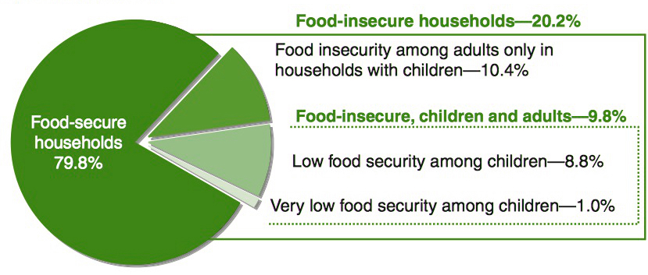
Unintended consequences of nutritional assistance programs:
Children’s school meal participation and adults’ food security
Teja Pristavec, Department of Sociology, Graduate School – New Brunswick, Rutgers, the State University of New Jersey
PURPOSE
To examine whether the provision of school meals to children is associated with the food security of adults within the household.
RESEARCH QUESTIONS
Is children’s school meal participation associated with adults’ food security?
How does the association change after controlling for child- and household-level factors?
How does the association change by participation level, subsidy level, benefit receipt frequency?
DATA
National Health and Nutrition Examination Survey (NHANES) 2007-2010
continuous, nationally representative
civilian, non-institutionalized US population
laboratory, questionnaire, physical examination components
Diet Behavior and Nutrition, Food Security
Sample N(analytic) = 2,449
household <185% federal poverty line
child attending K-12
NSLP institutional availability
Variables
Dependent: adult food security (USDA HHFSSM)
score, categorical, binary, individual items
Independent: child program participation
participation level, subsidy level, benefit receipt frequency
Control: child-level, household-level
METHODS
Weighted regression analysis using STATA 13.
RESULTS & INTERPRETATION
child’s school meal participation negatively associated with adult food security
(b=-0.68, sd=0.25, p<0.05) → explained away in adjusted model
child participation in more programs and higher subsidy level negatively associated with adult food security
NSLP and SBP (b=-0.62, sd=0.25, p<0.05); free lunch receipt (b=-0.97, sd=0.30, p<0.01)
Hispanic ethnicity, larger household, emergency food receipt negative predictors significant across models
→multiple hardships and self-selection
Predicted probabilities of adult FS conditions by children's school meal participation
**
*
*
BACKGROUND
Food security = sufficiency + access + nutrition & safety + acquisition & social acceptability (Anderson 1990)
Household food insecurity: negative outcomes for both adults and children (Nord & Parker 2010), but differences in food security status:
adults fare worse than children
Adult buffering (Bhattacharya et al. 2004; Maxwell 1996)
The role of schools & child nutritional assistance
National School Lunch Program
School Breakfast Program
sufficient food provision (Briefel et al. 2009)
intra-household food resource reallocation (Smith et al. 2012; Schmidt et al. 2013)
reduce adult buffering
association with food security?
*
US households with children by food security status, 2010
*p<0.05; **p<0.01
Source: Coleman-Jensen et al. 2012
Predicted adult FS score by child program participation and subsidy level
14-19
6+
no
high
NSLP and SBP
Hispanic
at/over $20k
no
11-13
no
no
*
marginal
4-5
yes
low
black
4-10
yes
**
NSLP only
under $20k
very low
no
white
1-3
yes
yes
Participation level
Subsidy level
*p<0.05; **p<0.01
child-level control
household-level control
LIMITATIONS & FUTURE WORK
data: cross-sectional → longitudinal (ECLS-K, SIPP)
controls: school-level, state-level (ECLS-K)
sample: certification error, undercoverage
REFERENCES
Anderson, S.A. 1990. Core Indicators of Nutritional State for Difficult to Sample Populations. The Journal of Nutrition 120 (11S): 1557−1600.
Bhattacharya, Jayanta, Janet Currie, and Steven Haider. 2004. Poverty, food insecurity, and nutritional outcomes in children and adults. Journal of Health Economics 23 (4): 839–62.
Briefel, Ronette R., Ander Wilson and Philip M. Gleason. 2009. Consumption of low–nutrient, energy–dense foods and beverages at school, home, and other locations among school lunch participants and nonparticipants. Journal of the American Dietetic Association 109 (2): S79–90.
Maxwell, Daniel G. 1996. Measuring food insecurity: The frequency and severity of “coping strategies”. Food Policy 21 (3): 291–303.
Nord, Mark and Lynn Parker. 2010. How adequately are food needs of children in low–income households being met? Children and Youth Services Review 32 (9): 1175–85.
Schmidt, Lucie, Lara Shore–Sheppard, and Tara Watson. 2013. The Effect of Safety Net Programs on Food Insecurity. NBER Working Paper No. 19558. Available online at: http://www.nber.org/papers/w19558 (Accessed 3/27/2014).
Smith, C, Parnell, W, Brown, R, and Gray, A. 2012. Providing additional money to food–insecure households and its effect on food expenditure: a randomized controlled trial. Public Health Nutrition 16 (8): 1507–15.

