Slide 1
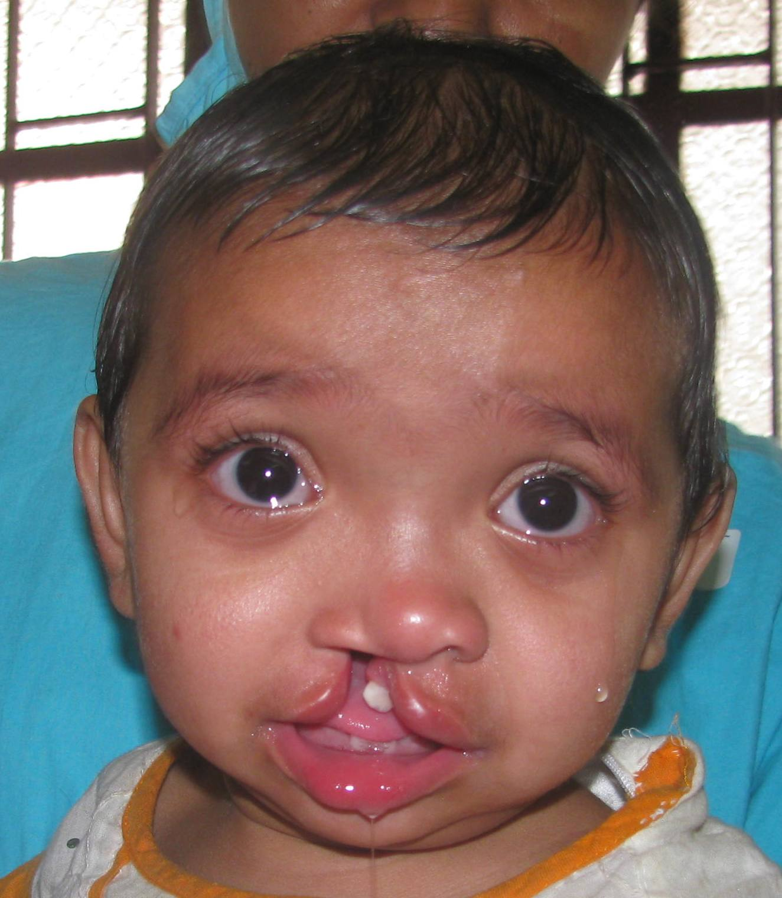
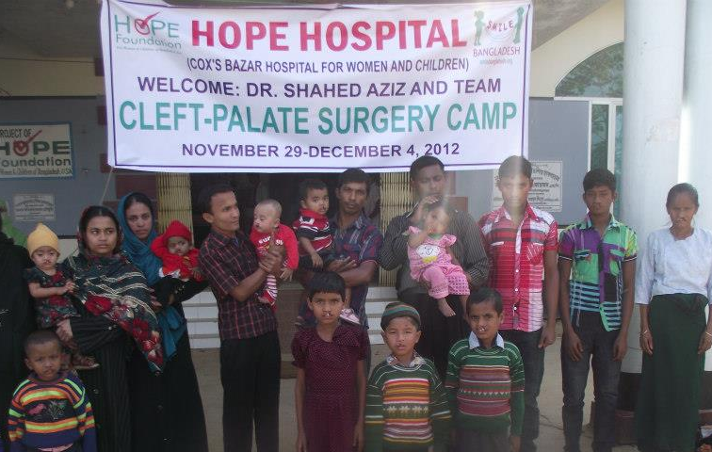
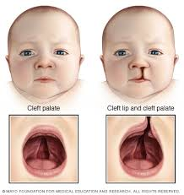
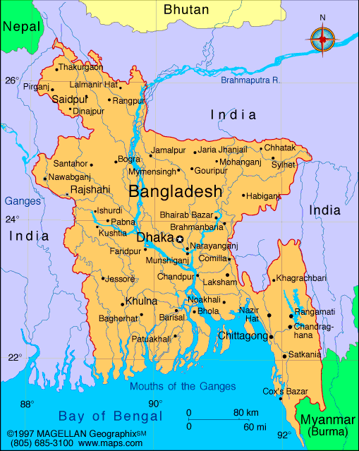
Addressing the Challenges of Cleft Lip in Bangladesh
Sonia Sandhu, Thomas Spanarkel, Christina Varghese, and Christa Otieno¹
¹Graduate School of Biological Sciences, Robert Wood Johnson Medical School, Piscataway, NJ 08854
Abstract
Cleft Lip Treatment in Bangladesh
60-minute surgical procedure
Cost of procedure is ~$300 per patient
Some NGOs offer free surgical procedures
Other than lack of access, many parents and individuals do not seek treatment. Why?
Superstitions exist in some rural communities that blame cleft lip on a pregnant mother cutting fish and vegetables while there is a full moon, so it is believed untreatable. The mother is held responsible and both the child and mother are alienated from society.
Methods
Current Efforts Worldwide
Cleft lip surgery is one of the most minimally invasive surgeries, yet it produces the most profound improvements both physically and psychosocially. However, congenital cleft lip deformity poses a huge health burden on the country of Bangladesh, with 300,000 children and adults with cleft lip; this figure rises by about 5,000 children per year. There are less than 30 trained cleft lip surgeons in the country, demonstrating a grossly inadequate physician to patient ratio. Untreated cleft lip predisposes the individual to multitudes of hardships, including infections, speech deficits, malnutrition, and social ostracization that can ultimately hinder mental and physical development. We aim to propose sustainable solutions to tackle this growing issue in Bangladesh. Working with current organizations motivated to improve cleft lip in Bangladesh, we intend to develop integrative solutions to increase surgical training, public health education, social justice, infrastructure and resource allocation to ultimately create a precedent in treatment of cleft lip and cleft palate.
Short Term Goals
Recruit and train community health workers and teachers
Public Health Education In:
Movement away from stigma
Causes of cleft lip
Prevention of cleft lip
Speech therapy
Feeding therapy
Counseling, emotional therapy
Continue current training of local physicians in left lip surgery by NGOs
Push for incorporation of community health into Bangladeshi medical school curriculum
Conduct community-based needs assessment
Long Term Goals
Change in Bangladesh Medical School curriculum: mandatory 1-year community health service
Increased physician pool trained in cleft lip surgery
Elimination of stigma
Mental, social, and speech rehabilitation programs established in schools and clinics
Establish Multiple Specialized Cleft Lip Centers in Bangladesh
The foundation for our project is inspired by to the increasing efforts of NGOs from around the globe, who are dedicated to resolving cleft lip and cleft palate in Bangladesh.
Smile Train
Their motto is “Teach a Man to Fish, Feed him for a lifetime.”
They utilize technology to train and utilize local partner hospitals and doctors and provide them with the resources, knowledge and skills to enable long-term sustainability. Smile Train has created a program that provides training and funding for local doctors to treat cleft lip. The program has over 40 doctors, support from 12 hospitals in Bangladesh and has supported 24,000 surgeries.
Operation Cleft
For over 10 years they have provided free operations for children suffering from cleft lip and palate in Bangladesh. Over the past years, with the support of their surgical team, operation cleft can lower costs for cleft surgeries allowing more surgeries for cleft lip to be provided. By this year, over 10,000 surgeries would be performed.
Hope for Bangladesh Established in 1999, this program has a goal to provide healthcare to women and children of Bangladesh. Not only do they offer basic medical care but they also provide cleft lip and palate surgeries For free. Partnered with Smile Train, Hope for Bangladesh is motivated to provide a combination of surgical repair, community outreach and feeding and speech therapy programs.
Introduction
Cleft lip is an autosomal recessive birth defect that affects
babies and is twice as common in males than females. It is
Defined as an opening on the edge of the lip, which may be
a small opening or it may extend to the nose. The cleft may
occur on one side (unilateral cleft) or on both sides(bilateral
cleft). The cause of cleft lip is unknown, however
Several factors increase likelihood of development.
Risk Factors:
pregnant women who:
Smoke
Have Diabetes
Are over 35 years old
Are taking anti-seizure medication
genetic makeup (inbreeding increases risk)
consanguinity
poor prenatal diet
If untreated, cleft lip can lead to:
Breathing problems
Feeding problems and malnutrition
High risk of mouth and ear infections
Speech impediments, loss of speech
Dental complications
Social Ostracization
Cleft lip/palate are conditions that occur worldwide,
but lack access to surgical interventions needed to repair
the clefts, which increases the burden of cleft lip in developing
countries. This is especially problematic in South East Asia,
specifically in Bangladesh and India, which has a high
prevalence of cleft lip and palate.
Cleft Lip in Bangladesh:
300,000 children with cleft lip currently
1:10,000 cleft lip surgeon to cleft patient ratio
Only 32 trained cleft lip surgeons in the country
Most patients are located rurally where there is high rate of illiteracy
Current Efforts by Smile Bangladesh
bilateral cleft lip patient
unilateral cleft lip patient
Smile Bangladesh
Their mission is to provide surgical, medical, & dental care for
Indigent children and adults with facial cleft deformities in
Bangladesh and throughout the world
They are a New Jersey based nonprofit medical organization that
have been sending medical teams to Bangladesh since 2006
With two mission trips a year, a dedicated team of volunteered
surgeons, anesthesiologists, pediatricians, nurses and administrators,
have operated and treated over 1000 children for cleft lip and
cleft palate in Bangladesh and they are continuing to grow and treat
more each year!
Why are We Doing This?
Every human on Earth has experienced the
struggles of growing up and finding their place in
the world. Children with cleft lip/cleft palate in
Bangladesh face unnecessary hardship. By
securing adequate opportunities and resources to
remedy these children’s facial deformities, we are
certain it will promote not only their psychological
perspective of the world but also their social
perspective. The adjustments suggested serve as a
means to reach a common end goal through
collective action. This is a duty that ought to be
performed to secure a comfortable, healthy and
bright future for the up and rising generation in
our global world.
Summary
Cleft lip/palate is a deformity that must be remedied
With the resources and the technological insight we have today, implementing methods and plans of action to provide the children of Bangladesh with an avenue towards a healthy and productive childhood and subsequent life is paramount
We are confident that the suggestions we provided would be not only beneficial to those with cleft lip/cleft palate but also to all the people of Bangladesh
Our hope is that that the suggestions we put forth may become a standard for the treatment of Cleft Lip/Palate in other countries with a similar situation to Bangladesh, and that successful application in these other countries leads to overall better health for their young generations
References
(Smilebangladesh.org, 2015).
(American academy of otolaryngology, 2015).
(kidshealth.org, 2015).
ACKNOLWEDGEMENTS: Dr. Christina Rozario for her work and presentation on Smile Bangladesh; pictures from SB trips used in poster

