Slide 1
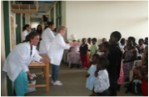
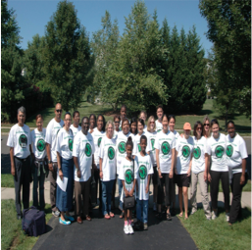
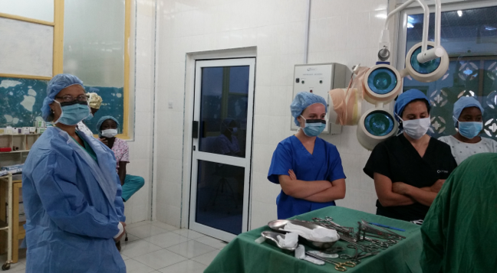
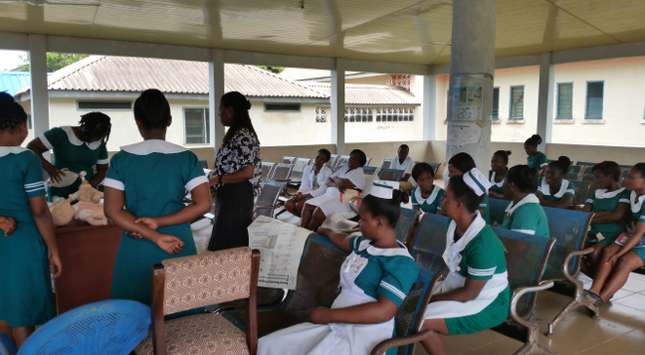
International Healthcare Volunteers
Kalyani Dhar, Lauren Miller-Lopez, and Phil Sgobba
¹Department of, i.e. ²Graduate School of Biological Sciences,Robert Wood Johnson Medical School, Piscataway, NJ 08854
Overview
The international healthcare volunteers is an organization dedicated to providing an American equivalent standard of healthcare to unprivileged populations in Ghana and Jamaica. The reason for intervention in these two countries is the large potential for efficient use of NGO resources. The absence of primary care allows the progression of easily preventable diseases. A plethora of resources are utilized in an effort to accomplish this goal. The combined effort of American health care providers, the cooperation of the host country, and large cooperation contributions allow for an American standard of healthcare in foreign countries. Extensive research was the basis for implementing the following programs: cervical cancer screening, colon cancer screening, and HIV prevention. A staple of the program is to provide lasting change by pushing for the integration of domestic and international healthcare practices. The program coordinators go through great lengths to ensure cultural competence. Health care provider knowledge of host country customs allows for better administration of care. The effectiveness of these three programs has been proven, just 360 volunteers have been able to change 11,000 lives.
Cervical Cancer Screening Program
The International Health Care Volunteers saw the need for a cervical cancer screening program in Ghana since there are 15.1 deaths per 1,000,000. The program was not only developed to go in and screen women, but was established to leave a program behind that allows the midwives to recognize and screen for cervical dysplasia. A partnership was established between the volunteer program and a number of institutions in Ghana. The institutions include: Central Regional Hospital Administration/Midwives, Ghana Health Service, Minister of Health, and African Methodist Women Group. Through the incorporation of these community groups, the International Health Care Volunteers were able to increase awareness in the community about cervical cancer and increase the training of the health care providers, mainly the midwives. This program is considered to be a success since the program was able to help many women and it is a program that is still in use today.
HIV Prevention
Program
The prevalence of HIV in Ghana has been steadily declining in the past decade and as of 2013 it was in around 1.3%. This may make it seem like HIV is not a major issue for Ghana, but in certain urban areas the prevalence rate is as high as 11.6%. It is in these regions where education and intervention is most useful. The International Health Care Volunteers saw that lasting changes could be made in these regions. A staple of the HIV prevention program was the involvement of the community and local health officials. This was crucial because HIV is a culturally sensitive topic. Partnerships with Public Health Nurses, Ghana Health Nurses, and Christian Health Services played an integral role in making a significant impact.
Colon Cancer Screening Program
The International Health Care Volunteers deemed colon cancer screening to be under recognized in Ghanna. This led the development of the organization’s second program: the colon cancer screening program. In an attempt to devise a sustainable program the organization formed partnerships with various organizations. Additionally, colonoscopy devices were donated to the program by various pharmaceutical companies. This program organized formalized training for providers to perform colonoscopies. Upon returning the KNUST hospital the following year it was found that few colonoscopies had been performed. This project was deemed a failure by the International Healthcare Volunteers. Although lack of colon cancer screening is a prevalent problem in Ghanna, the citizens did not view it as so. This project demonstrated the importance of considering community opinion and culture.
5.
6.
Summary
7 .
Methods
-Determine health goals
-Consider community culture
-Team members work within their scope of practice
and level of medicine
-Team members train local physicians, nurses, and
midwives in order to develop a sustainable program
-Form partnerships with hospitals, medical staff,
organizations
1.
Conclusion
The International Health Care Volunteers (IHCV) was established in 2001 to enhance the health care provided to women and their families in the underserved areas of Ghana. The organization does not only provide care, but also believes in sustainability so that the country itself can provide care to their citizens even when the IHCV volunteers are not present. IHCV does this by incorporating the facilities of the community such as hospital staff, medical school, and churches. IHCV established three programs to address the key health issues of the community, the programs are: Cervical Cancer Screening Program, Colon Cancer Screening Program, and the HIV Prevention Program. Although these programs were organized to help better the health of the community, only two of three programs were successful. However, IHCV continues to work towards a healthier Ghana and through the hard work of 360 volunteers, IHCV was able to provide care to 11,000 individuals.
1.
Notes:
1

