Slide 1
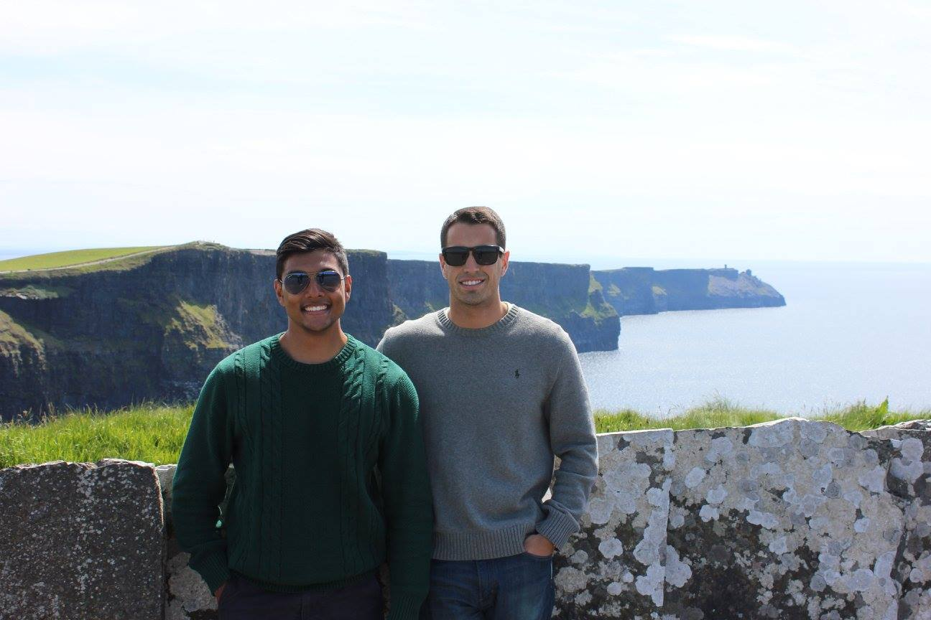
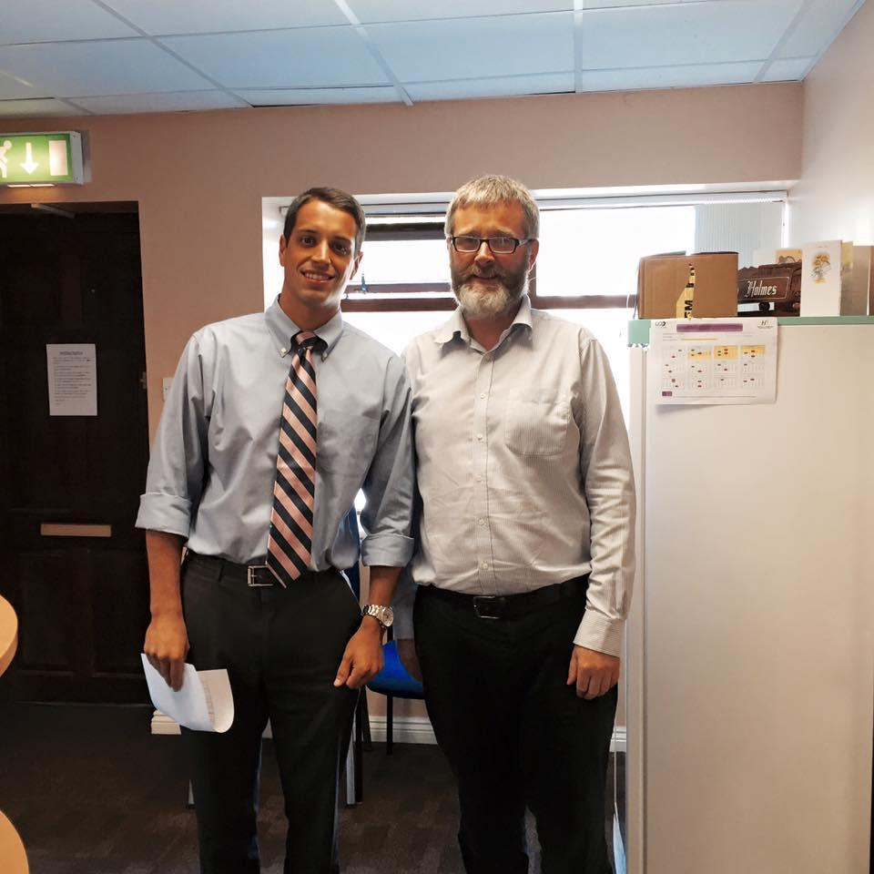
Sam Sauerwein
Arjun Patel
University of Limerick Graduate Entry Medical School
2015 Summer Elective
Introduction: This past summer, we participated in an medical exchange program in Limerick, Ireland, in which we gained significant international healthcare experience both clinically and culturally.
Program Description
The program is offered through UL GEMS, a medical school offering a 4 year medical degree open to graduates from any discipline
Largely based out of Limerick Regional Hospital where we spent 2 days/week in endoscopy and surgery
3 days/week were spent with local General Practitioners working on history and physical exam skills
Reasons for Going Abroad
To gain experience in an international healthcare setting and to work with a unique patient population
To fine tune skills in eliciting patient histories and performing physical exams
To learn about the pros and cons of a different healthcare system and how it alters the way medicine is practiced abroad
Summary: The program itself was conducted through the Graduate Entry Medical School at the University of Limerick, which is a post-graduate medical school similar to what is seen in the United States. We split time between the hospital and GP offices, which provided exposure to both outpatient and inpatient medicine. In the hospital, we were exposed to a variety of invasive procedures that we had never had a chance to observeback home. We were also able to gain substantial experience in taking histories and physical diagnosis in the primary care setting. Finally, we had an incredible time becoming immersed in the Irish culture and seeing all the sights that the country had to offer.
Cliffs of Moher, Co. Clare, Ireland
Background Information - Ireland
Average Annual Income - $28,788
Healthcare Spending - $3,000 per capita
Infant Mortality Rate - 3/1,000
Adult Mortality Rate - 140/1,000
Languages Spoken - English and Irish Gaelic
7.
Sam and GP Dr. Liam Holmes
Conclusions
A perfect healthcare system does not exist! A different system in Ireland came with its own challenges.
We are forever grateful to the physicians and people of Ireland who were eager to teach us and facilitated an outstanding learning experience!
Our time abroad has sparked our interest in completing an international away rotation during our clinical years.
Program Contact Information
UL Graduate Entry Medical School
GEMS3-011
University of Limerick
Email: medicalschool@ul.ie
Phone: 00-353-61-234850
.
CAPTION
Notes:
1

