Slide 1
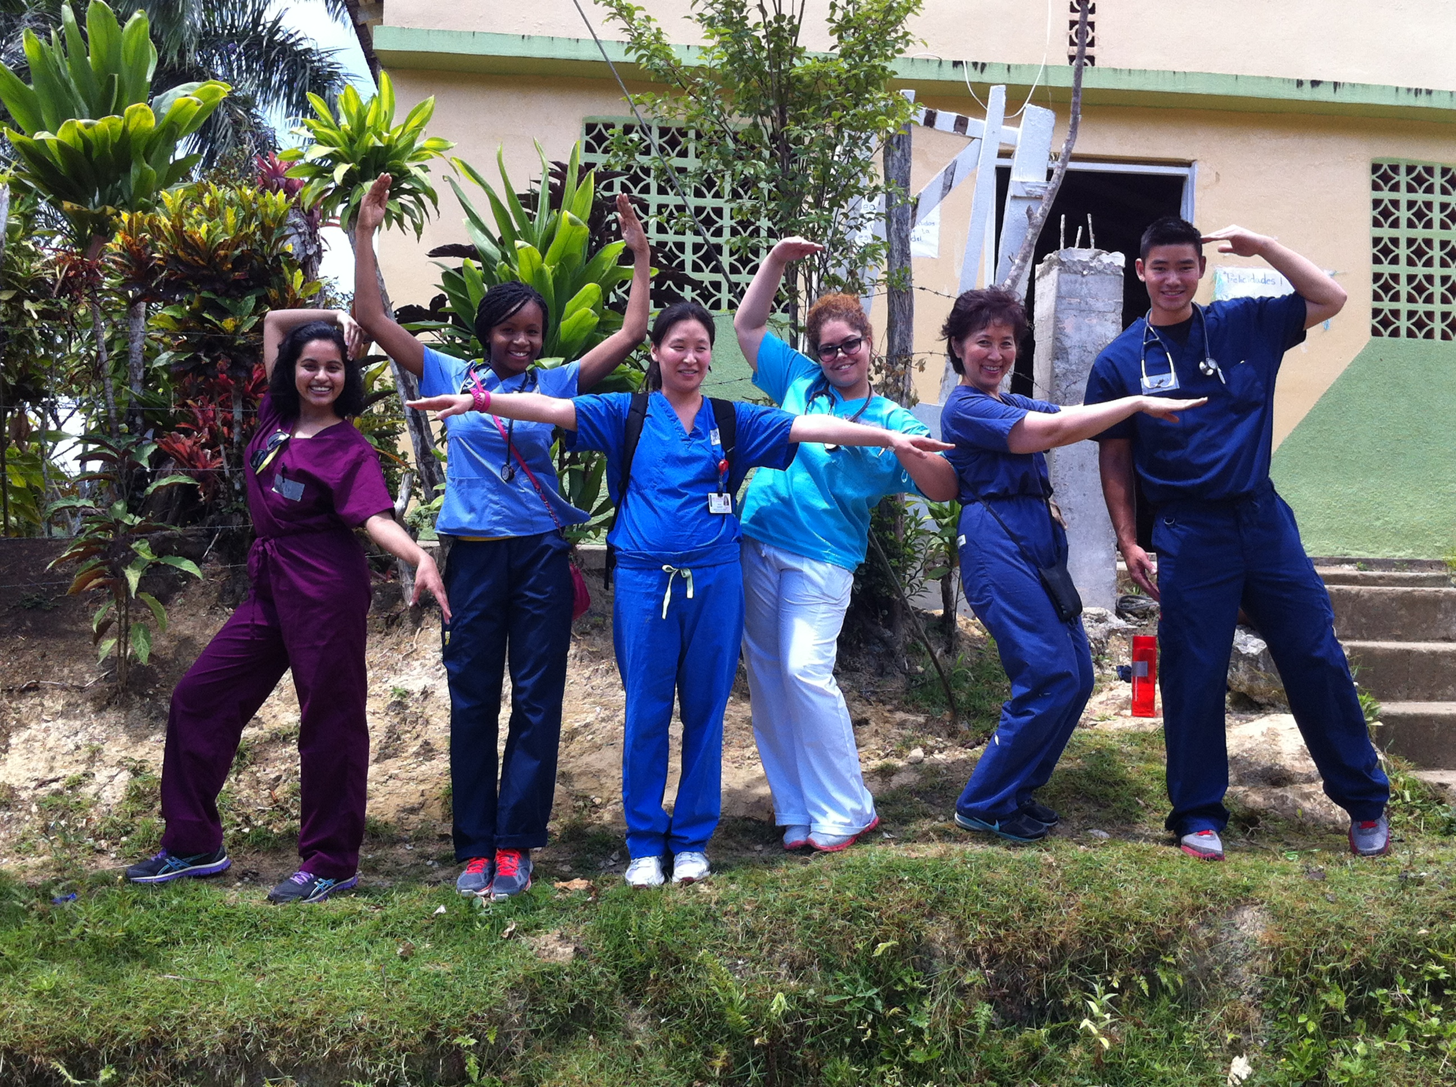
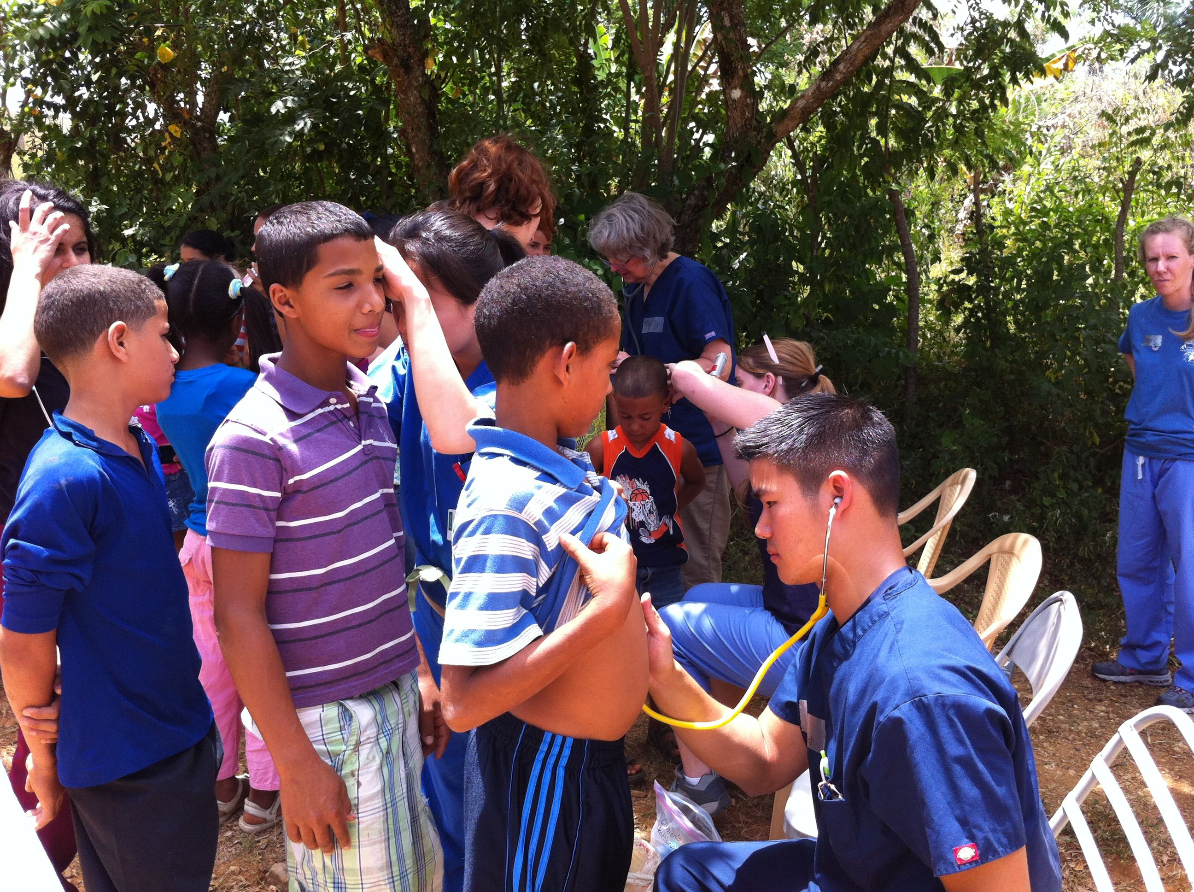
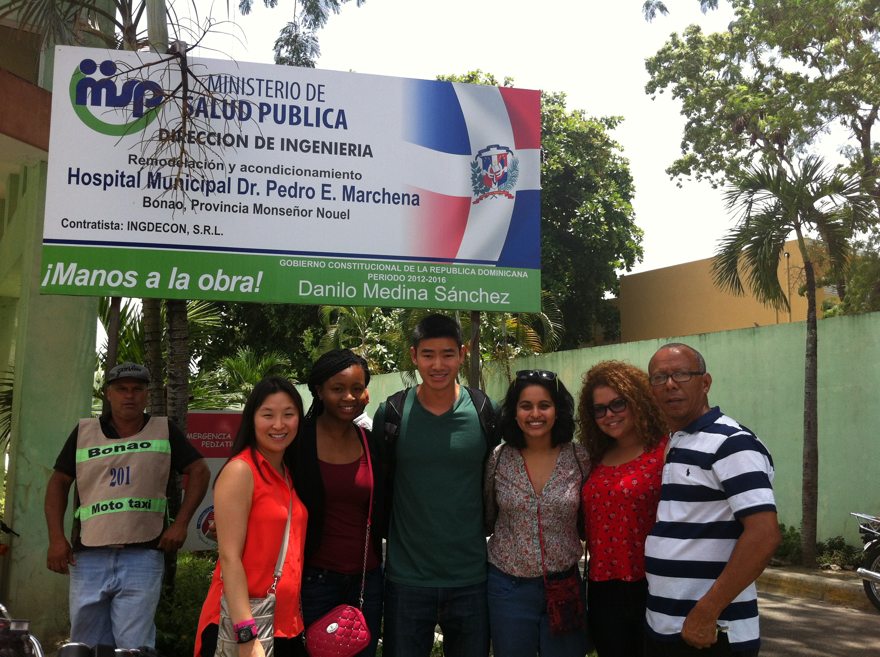
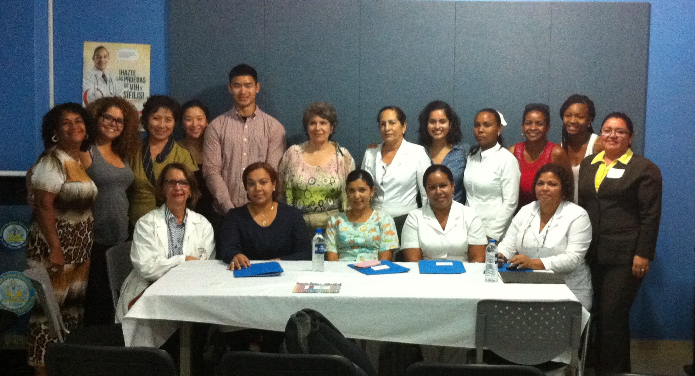
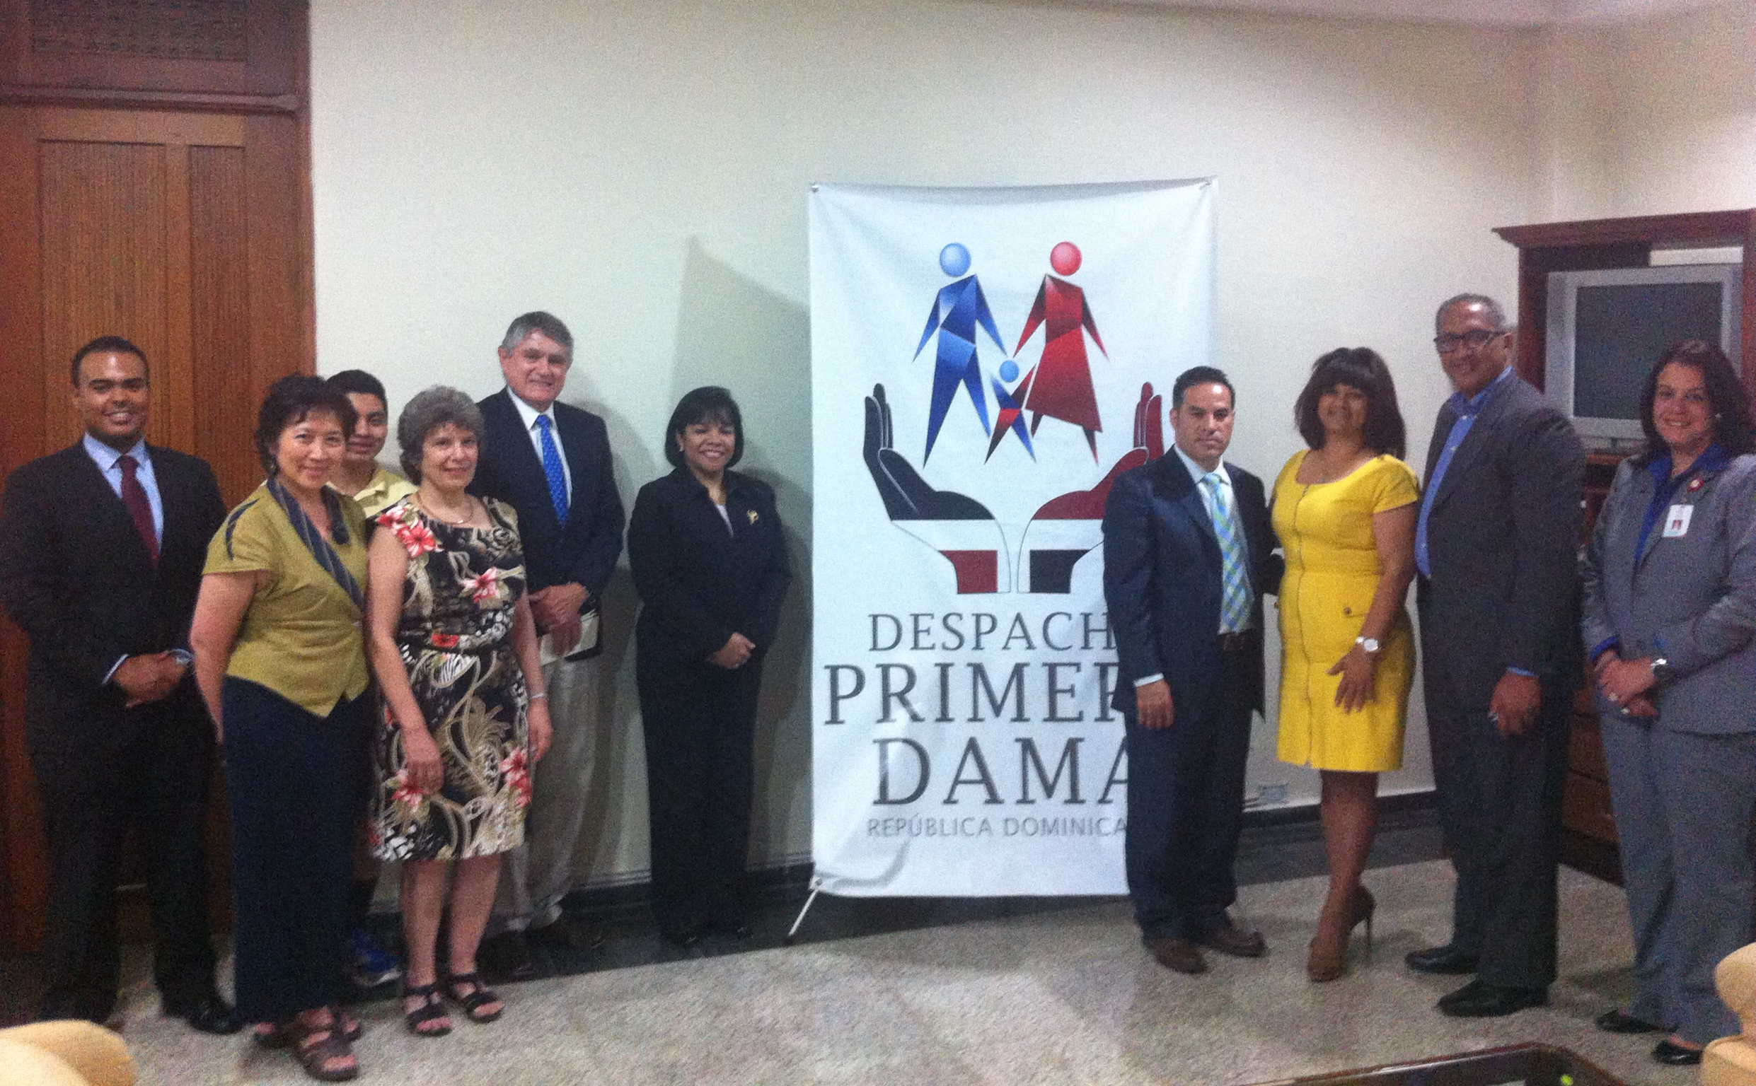
The Impact of Inter-Professional Education on Global Health
Karen W. R. Lin, MD, MS; Susan Caplan, PhD, APRN-BC
Abstract
The project is to examine the existing mental health care services in the Dominican Republic, and understand the the barriers, needs and resources to treatment of mental health.
To explore potential strategies to improve services delivery in the primary care setting and at a national policy level.
Objectives
To assess the mental healthcare services in five regions of the Dominican Republic.
Allow students to acquire skills to conduct focus groups and workshops, interpreted and transcribed recording and non-verbal body languages; appreciated interdisciplinary approach towards mental health, domestic violence and home visits.
Reflections
Tsui: A man with schizophrenia was incarcerated in concrete backyard shed built by his family; this seemed at first cruel and inhumane, but that this was the optimal solution for the man. This is just one of many cases of unmet mental health needs. this trip was invaluable because of the overwhelming culmination of perspective-broadening experiences. Continue to conduct mental health research with Drs. Caplan and Lin, and my student colleagues after return to US, continue to put our work into perspective
Clerjuste: Just because two individuals are speaking “Spanish”, does not mean they are speaking the same dialect, believe in the same things, have the same culture. The data we've gathered only tells us that there is still much to be done with that community, and it is up to us, the new generation of doctors and nurses, to continue educating them about Mental illness and how to manage it.
Nahar: Through focus groups we were able to appreciate what nurses, doctors health care providers’ personal perceptions of treating persons with mental illness, the existing mental health services, stigma towards treatment of women suffering from domestic violence, and adolescent suicide. It was such a privilege and incredible experience to meet so many amazing people- students, health care providers, patients, and families. I will forever cherish every moment and hope to get the opportunity to return!
Queen: Being invited into the homes of strangers to listen to their personal journeys of caring for mentally ill family members was a moving experience that emphasized the humanity of our mission. The richness of our experiences taught us not only about Dominican society and culture, healthcare system but also about justice, empathy and the desire to help others that fuels us all as health care providers.
Brou: It was interesting to see that despite the economic status of a country, the underlying issues concerning provision of care are universal. The trip provided insight into some obstacles faced in addressing mental health in a low resources setting. It also provided a good lesson in the power of resilience and determination.
Background
“Chronic, Severe Mental Disorders in the Dominican Republic: Teambuilding and Discussion Groups” was sponsored by Rutgers Global Advancement and International Affairs, lead by Dr. Caplan.
This project is to assess the progress since 2005, the last data used in the comprehensive report of PAHO/WHO 2008 country-wide assessment of mental health services.
An interprofessional team of faculty and students from RBHS were formed in July 2014, the second trip was in January 2015.
How would IPE impact on career choices? The prior interest before medical/nursing school, an enrichment elective, location, quality, reputation, career path, future fellowship training opportunities and morale could be contributing factors according to international surveys.
Methods
The team participated in the medical mission with volunteers of The University of Southern Maine in resources-limited villages, followed by five focus groups discussion at local institutions in varies locations.
There were face-to-face communications with 36 native participants, including nurses, physicians, medical students, occupational therapists, psychologists, psychiatrists, hospital administrators, ministry of health officials, non-governmental foundation public health workers, and regional health care administrators.
Following the initial trip, monthly conference calls were set up among faculty and students to summarize literature research, transcription and translation.
Follow-up visit 6 months later to interview with same groups of interdisciplinary teams, provided opportunities for them to review transcriptions, and further clarifications.
Acknowledgement
Susan Caplan, PhD, APRN-BC, School of Nursing, Rutgers University, Newark, NJ
Karen W.R. Lin, MD, MS, assistant dean of Office of Global Health, Family Medicine and Community Health, Rutgers RWJMS, New Brunswick, NJ
Javior Escobar, MD, associate dean of Office of Global Health, Psychiatry, Rutgers RWJMS, New Brunswick, NJ
Kaila Queen, Jonathan Tsui, Ritu Nahar, students of Rutgers RWJMS, Piscataway, NJ
Erika Clerjuste, Grismer Gonzalez, Deborah Brou, students of School of Nursing, Rutgers University, Newark, NJ
Result
“Stigma” and “ lack of resources”
are identified as the barriers for both patients and healthcare professionals. Integration of mental health into primary care and interdisciplinary education might reduce stigma.

