Slide 1
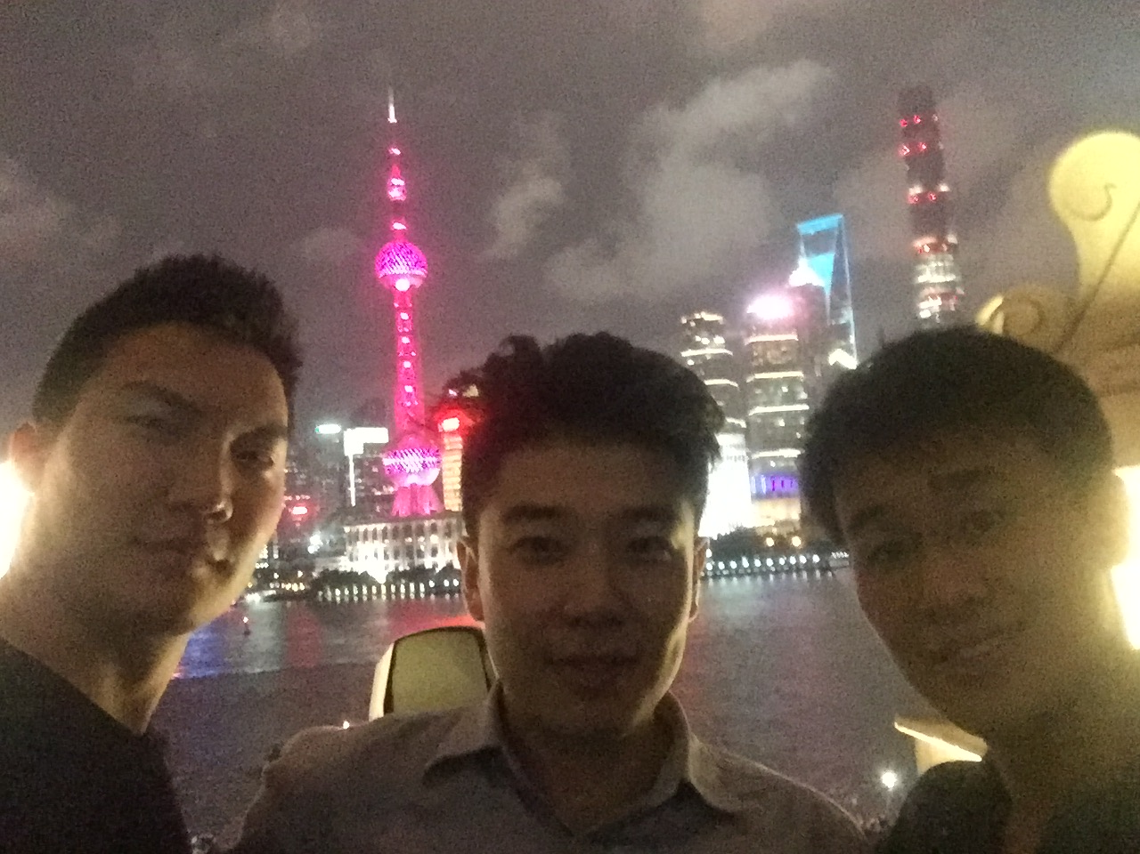
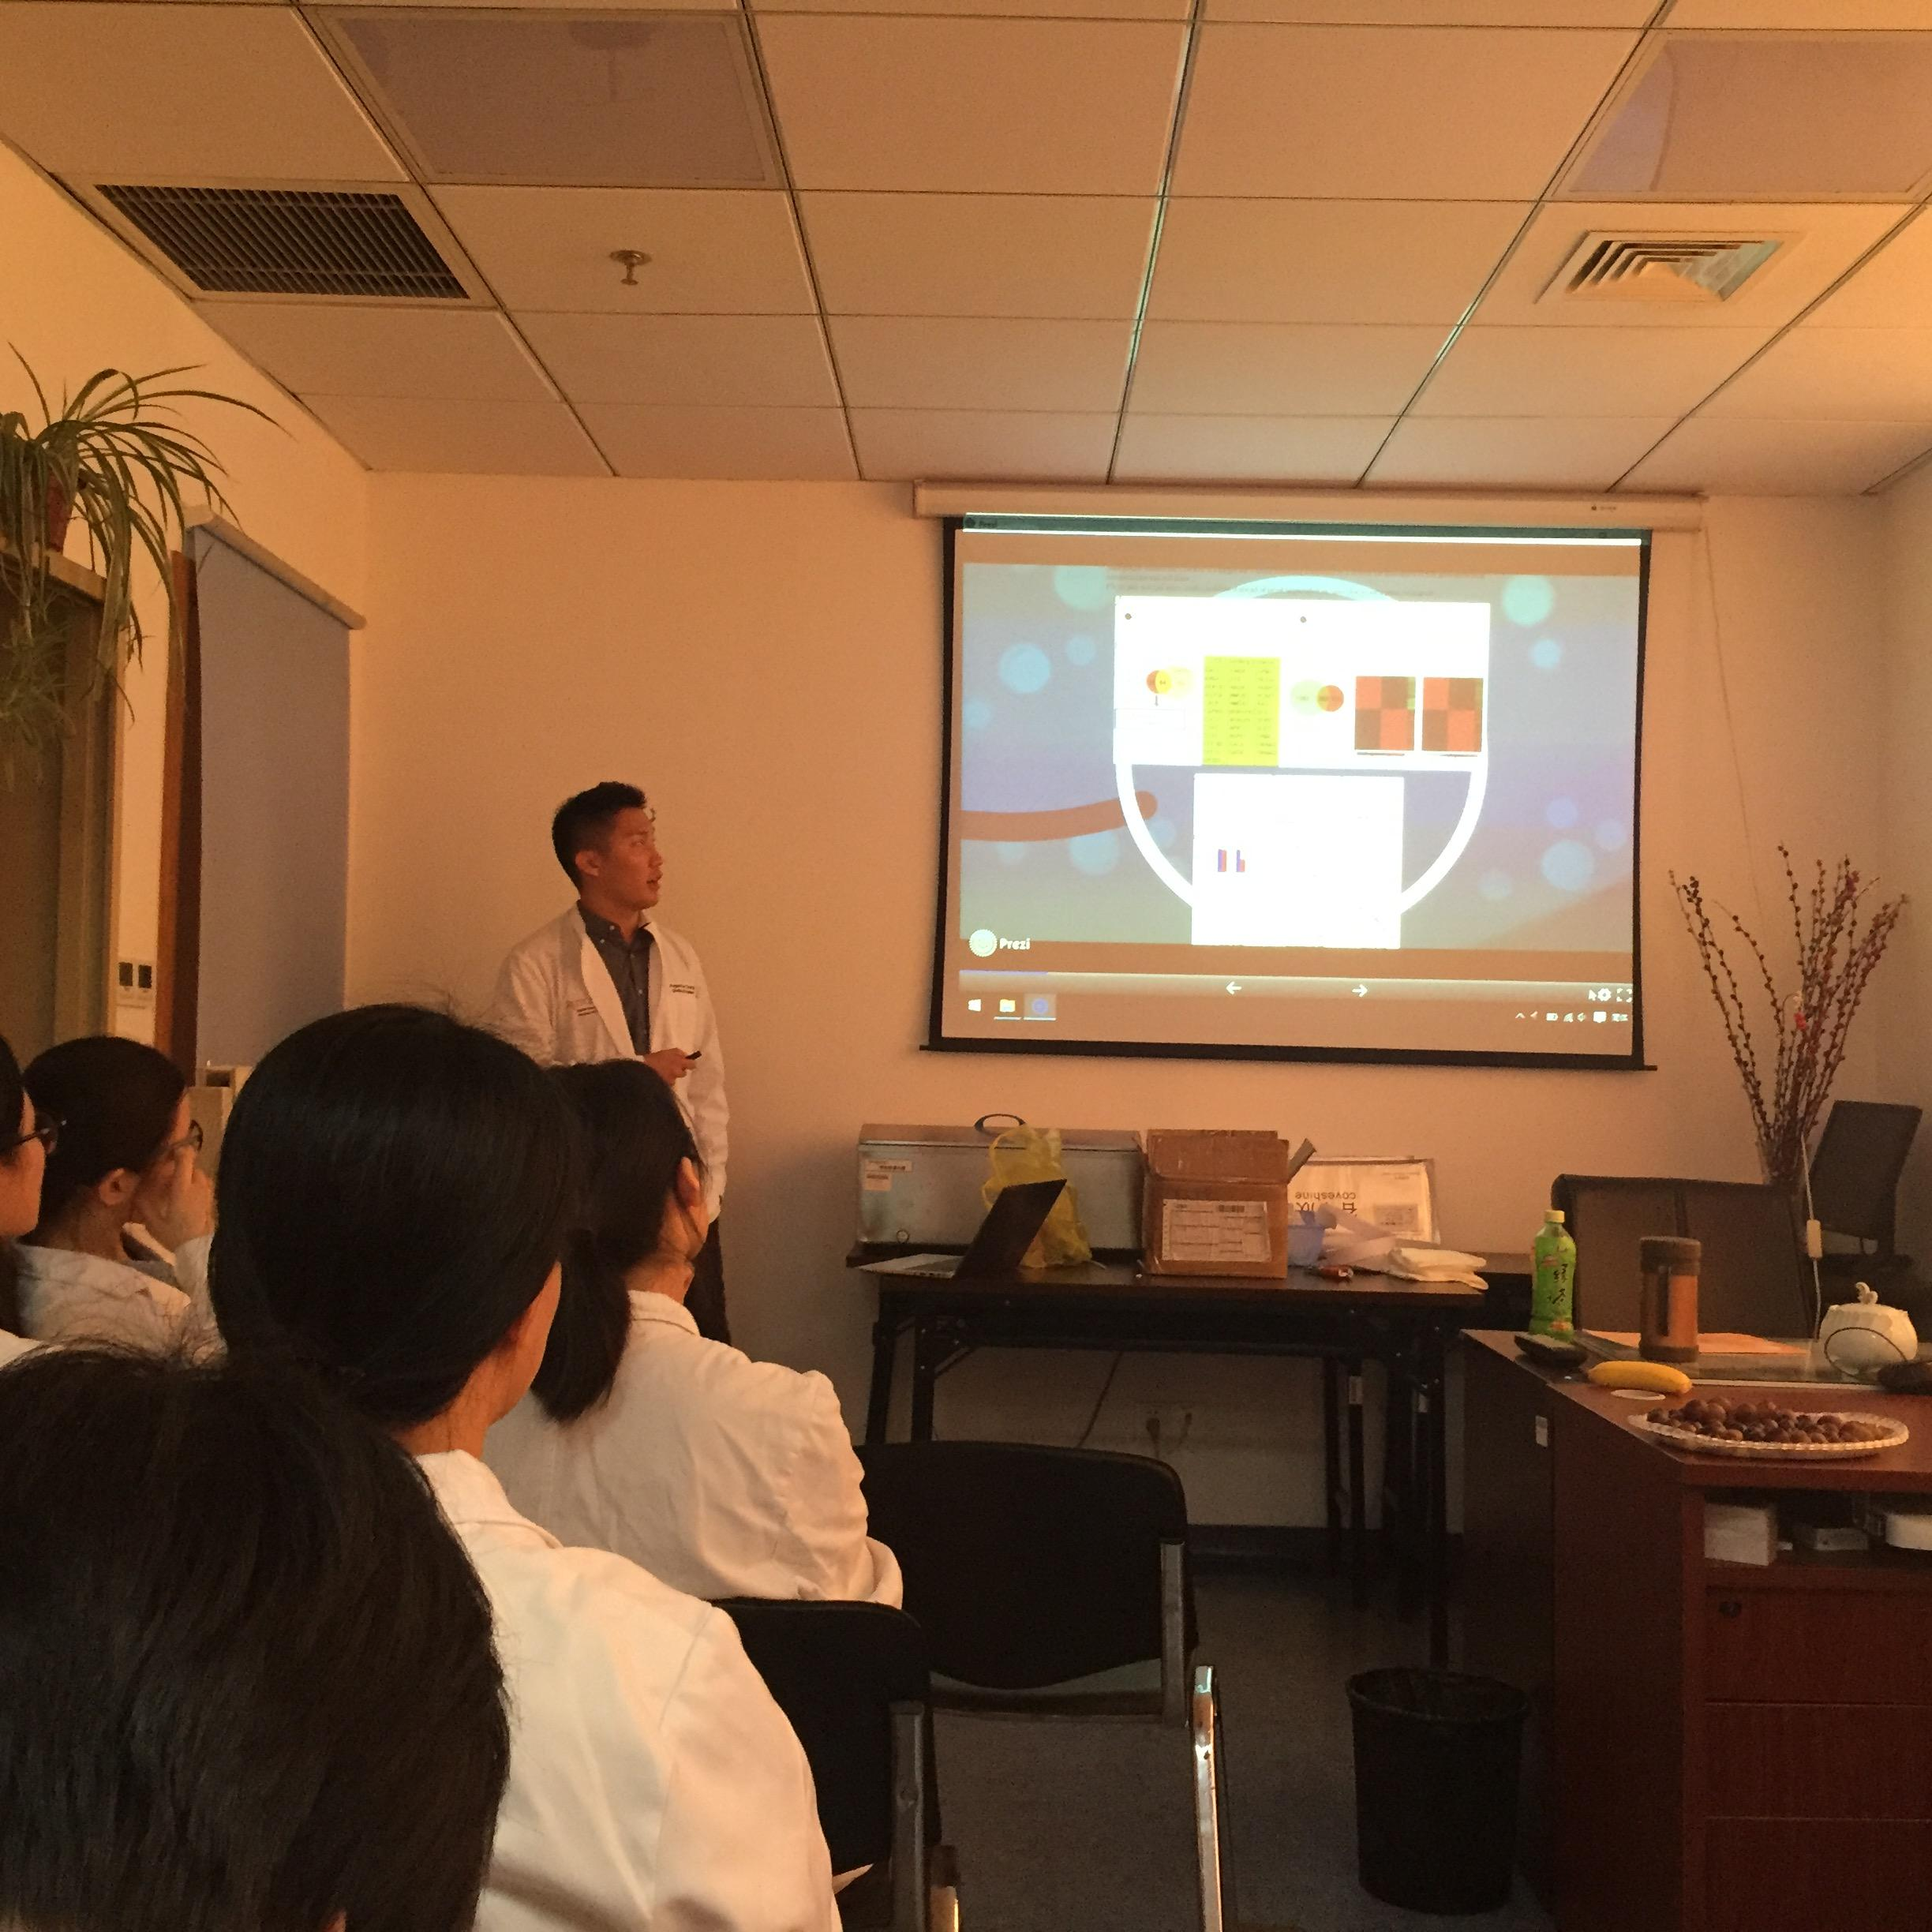
Shanghai Jiaotong University 9th People's Hospital Summer Global Health Experience
Augustus Chang and Raymond Cai
Robert Wood Johnson Medical School, Piscataway, NJ 08854
Introduction
Shanghai Jiaotong University 9th People's Hospital was founded in 1920 and currently serves the Baoshan District of Shanghai, China with 1000 inpatient bed and 33 clinical departments. Over the past summer, we performed clinical rotations through the Oncology and Plastic Surgery Departments, and gained a clinical understanding as well as increased insight into the cultural and socioeconomic factors that engender health care delivery in global contexts.
Program Information
This summer experience was sponsored by Rutgers RWJMS Office of Global Health, Rutgers Cancer Institute of NJ, Rutgers GAIA and Shanghai Jiaotong University. We each performed a 6 week rotation in our respective departments in Oncology and Plastic Surgery. We had the opportunity to shadow inpatient and outpatient services, scrub in for surgical procedures, conduct collaborative research with medical students and faculty, and participate in educational lectures which were conducted bilingually in Chinese and English. We also had the opportunity to electively shadow in different clinical departments of our interest. As a capstone of our summer experiences, we both prepared a lecture regarding an individual research topic of interest, which we presented to the medical students and doctors in our department.
Summary of Trip
Having the opportunity for a global health experience in Shanghai, China allowed us to gain additional clinical exposure and practice Medical Mandarin, as well as understand the challenges of healthcare delivery in a global context. We gained insight into the unique epidemiological challenges that China faces due to its immense population and scarce resources, especially in regards to access and affordability of healthcare. While China purportedly has near universal health insurance coverage, there are different tiers of coverage depending on location of residence, which results in inequities in care for vulnerable populations such as migrant workers. For example, while genetic screening of tumors is widely available in Shanghai hospitals, due an independent Chinese FDA approval process for medications, many oral targeted therapies are either legally imported into the country, at high cost, or illegally procured as generics on the black market. Understanding the difficulties that patients and doctors face in overcoming these barriers in providing care is integral to becoming culturally competent, patient centered physicians both globally and at home.
Background
The Shanghai municipality of China is an extremely densely populated city with about 24 million people living in a 2.4 thousand square mile area. The average annual salary of each citizen is the equivalent of $16,600 USD, the 3rd highest per capita GDP in the county. Most of the citizens of the city speak Mandarin; however, there is a sizable portion of the population that also speaks the local dialect, Shanghainese and a smaller portion that speaks the dialects of neighbouring districts. [1,2]
In 2000, Shanghai implemented several health reforms to match the explosive growth of the city. The government allocated 70-80 RMB (11-13 USD) per capita for health care spending, a threefold increase compared to the national 25 RMB (~4 USD). By 2010, Shanghai was able to reduce the rate of avoidable mortality (defined as deaths that could have been prevented with good quality healthcare and current medical technology) from 72% down to 50%. [3]
Statistics About Health in China [4]
- Healthcare Expenditure: 5.5% of GDP
- Physician Density: 1.49/1000 people
- Life Expectancy: 75.5 years
Male: 73.5 years
Female: 77.9 years
- Infant Mortality Rate: 12.2/1000 births
Male: 12.2/1000 births
Female: 12.4/1000 births
- Obesity Prevalence: 7.3% of population
References:
[1] "Shanghai Population 2016." - World Population Review. N.p., 26 Oct. 2016. Web.
[2] "National Data." National Bureau of Statistics. N.p., n.d.
[3] Ren, Yuan. "Health Improvements for a Healthy Shanghai Rising Comment on "Shanghai Rising: Health Improvements as Measured by Avoidable Mortality since 2000"" International Journal of Health Policy and Management 4.3 (2015): 189-90.
[4] "The World Factbook: CHINA." Central Intelligence Agency. Central Intelligence Agency, n.d. Web.
Sponsors
Rutgers Global Advance of International Affairs
Rutgers Office of Global Health

