Slide 1
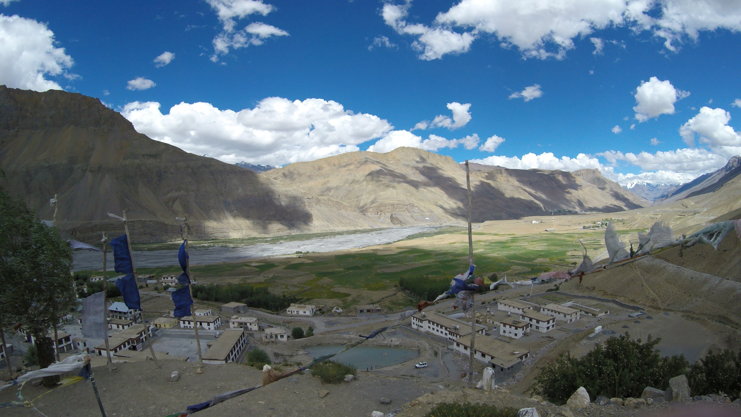
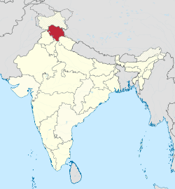
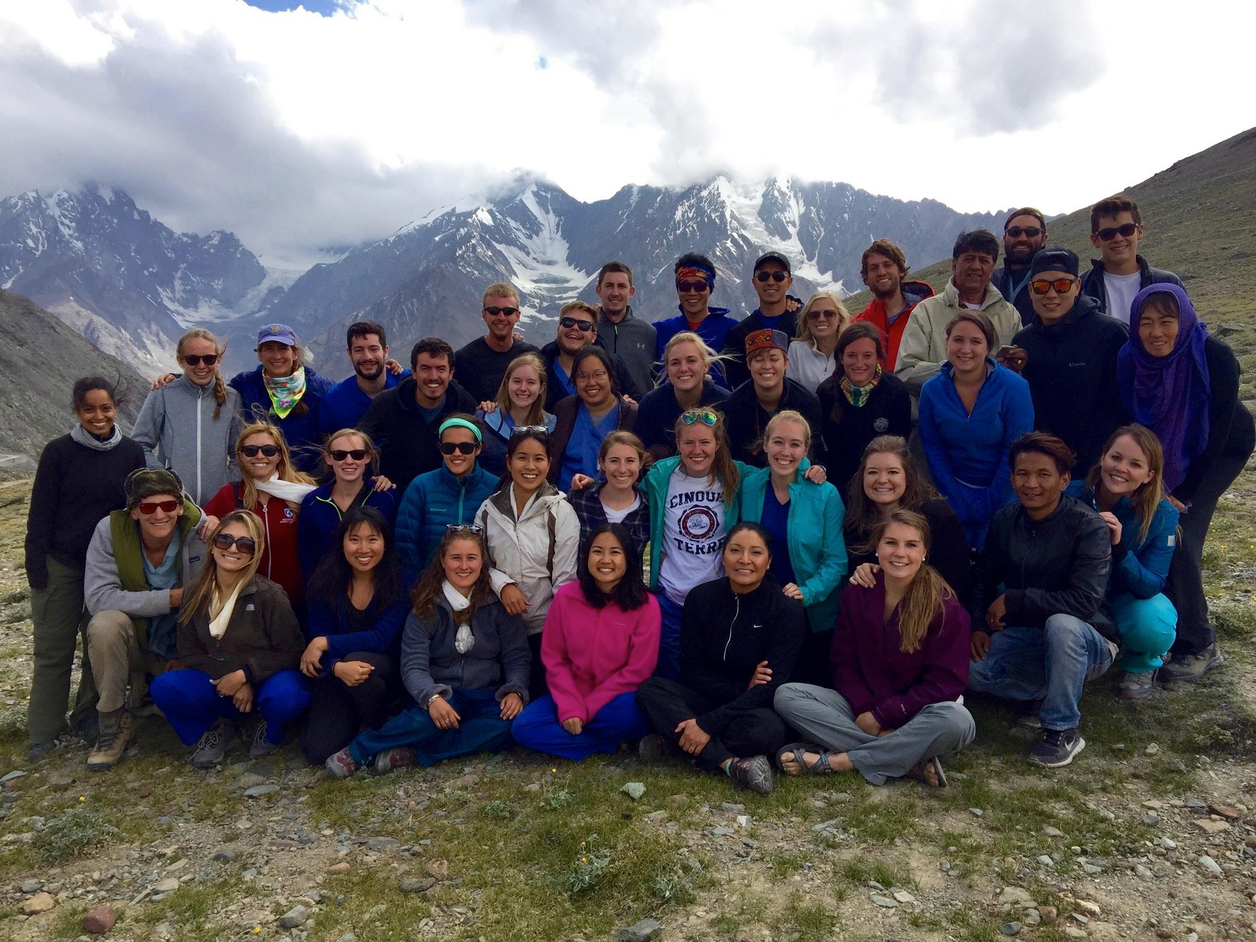
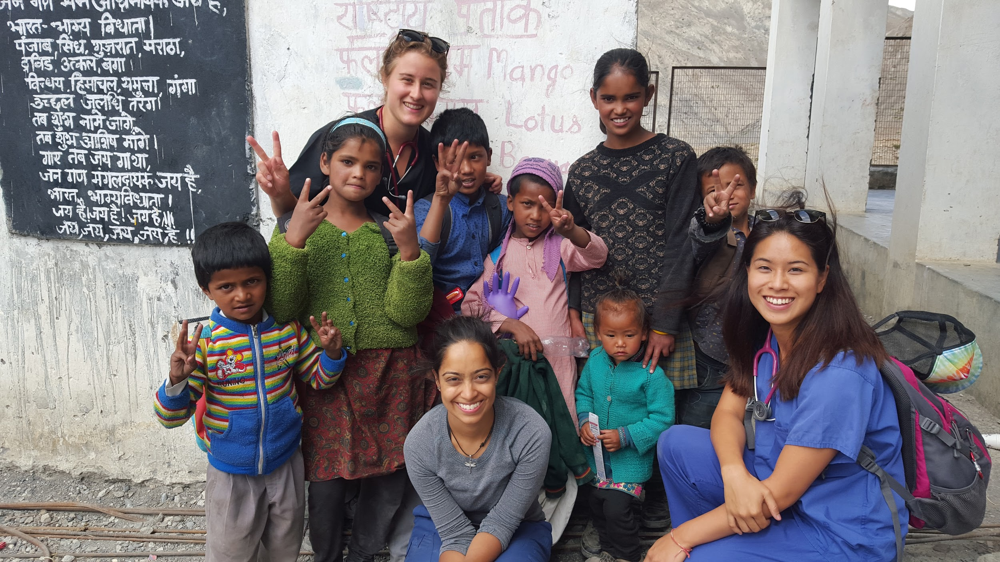
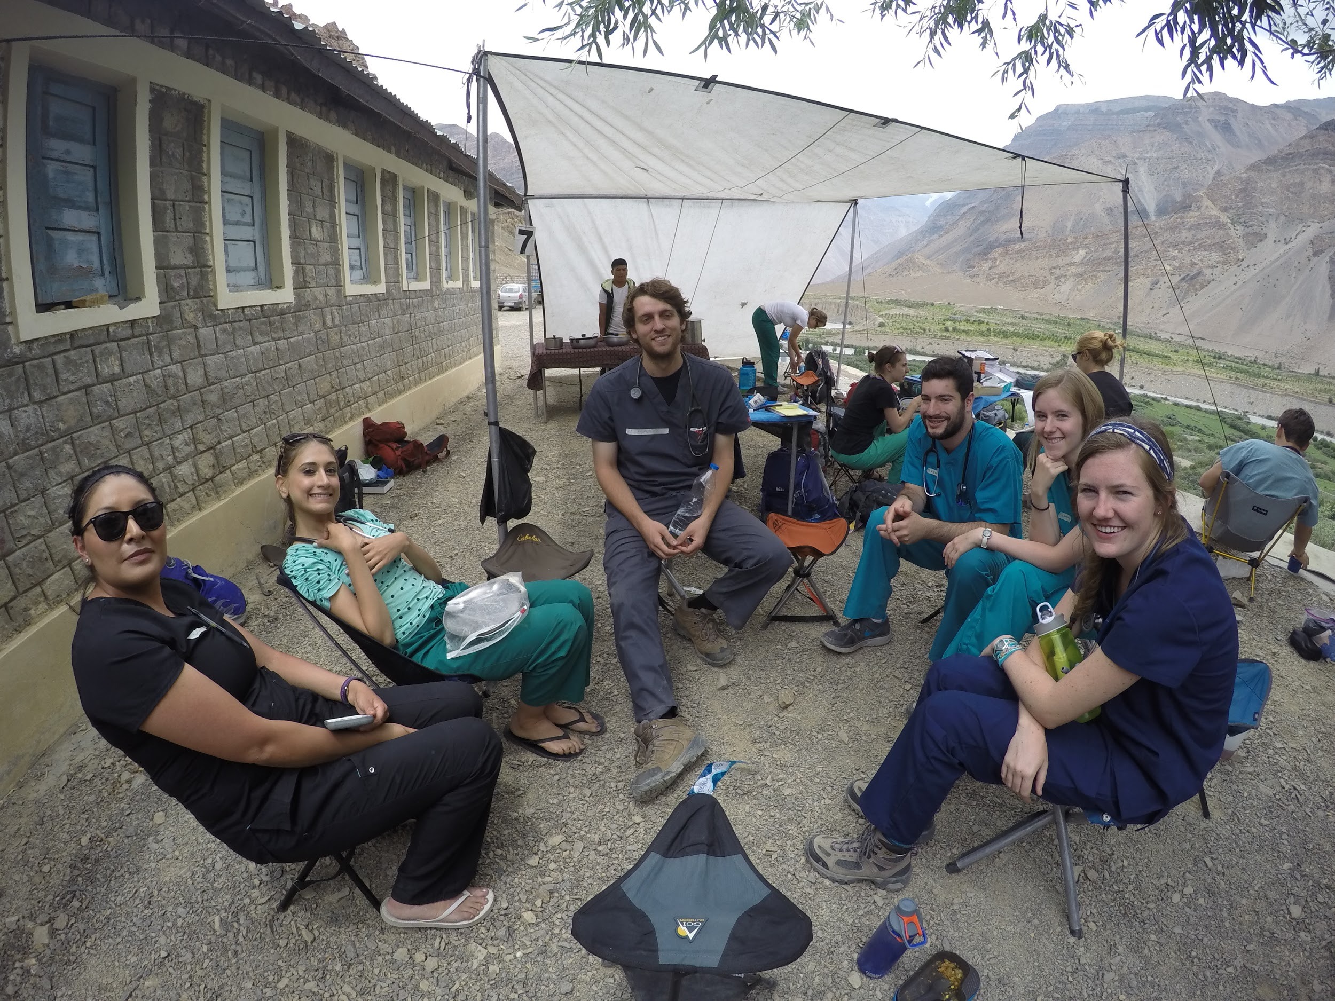
Common Health Concerns Facing the People in the Himalayan Region
Matt Bittner, Ankita Tripathi, Jung Yum, Victor Razuk
Office of Global Health, Robert Wood Johnson Medical School, Piscataway, NJ 08854
INTRODUCTION:
Spiti valley region faces with providing safe and efficient health care to its residents which motivates organizations like Himalayan Health Exchange to perform medical trips to the region. The trips provide a great cultural and unique clinical learning experience for US doctors, residents and medical students. The high prevalence of certain diseases and conditions provide a wealth of experience, which can be applied to future patients from our own region.
OBJECTIVES
Provide free medical care to the inhabitants of Spiti Valley and educate them on ways to prevent diseases.
Become aware of the prevalence of different types of diseases and to come up with reasonable and accessible treatment plans.
Learn about the ways different cultures perceive and use medicine, and compare them to western medicine.
To work in a team based setting with various roles (e.g. translator, examiner, scribe to treat patients.
Reflect upon potential changes that can be implemented to improve health care in areas with limited healthcare resources.
Reflect upon the benefits and limitations of global health trips.
CLINICAL FINDINGS/RESULTS:
Major health issues
Eye maladies
Primary health concern
Pterygiums
Large keratinous growth - medial aspect of the eye. Infringes visual acuity if they grow to cover the pupil
Farsightedness
Cataracts
UV light main precipitating factor - high altitude
Program distributed sunglasses to those patients with eyes condition to prevent any further exacerbation
Body pain
Locals were migrant or farm workers
Greater incidence of myalgia and arthralgia
Abdominal pain
Secondary Health Issues
Constipation
Consume low fiber diet - large quantities of rice and bananas
GERD - spicy diet, oily foods
Sciatica
Anemia, dehydration
Vitamin deficiency children
HHE Clinic Setup
16 service staff
INTAKE
6 healthcare professionals
(5 physicians, 1 pharmacist)
General Medicine
Pediatrics
Ob/Gyn
BACKGROUND: Himachal Pradesh and Spiti
Indian state located in the northeastern region
12 districts one being Spiti that borders Tibet
Total population ~ 6 million people (90% rural areas)
Spiti total population ~ 10,550
Average altitude 5000 to 6000 feet above sea level
Exacerbate the potential for eye deficits and altitude sickness
Limited access to electricity or internet
Myriad health issues affecting the region due remoteness and lack of access to quality healthcare services and interventions
2nd highest immunization rate among 12-23 month children (~ 85%)
2nd lowest Infant mortality rate and under-five year mortality rates among Indian states in 1998-1999
3rd lowest fertility rates ~ 2.1 children per female
Spiti Valley Disease Prevalence
Chronic mountain sickness - 6.17%
Hypoxemia, dyspnea, and polycythemia
Chronic mountain sickness above 3000m - 13.73%
High altitude pulmonary hypertension - 3.23%
Increasing age is a primary risk factor
Hypertension - 22.5%
Obesity 17.4%
Attributed to agricultural lifestyle being the main occupation
Diabetes 0.4 %
Seropositivity of Syphilis - 0.73% in 1999
Overall prevalence of STDs - 23.9%
Main 5 morbidities in 1998
Acute bronchitis - 17.18%
Anemia - 15.81%
Dental diseases - 11.18%
Gastroenteritis - 9.54%, Skin diseases - 9.54%
Pharmacy
Himachal Pradesh; location of clinics
33 students
METHODS:
Himalayan Health Exchange
54 team members
16 service staff
33 students
5 doctors
1 pharmacist
Clinic setup
Intake tent: triaged pts, took vital signs
General medicine tent: students would interview and examine patients and present their findings to the physicians on staff
Pediatrics tent: similar setup to general medicine tent
Ob/Gyn tent: similar setup to general medicine tent
Pharmacy: most patients were sent to the pharmacy after consult
Clinic locations
Himachal Pradesh, India: Sumra, Gui, Chandigarh, Tabo, Poh, Dhankar, Rangrik
Patient load
10 total days of clinic
1,237 total patients seen
CONCLUSIONS:
There is a plethora of health concerns that inflict the patients in Spiti valley, yet very limited resources allotted to decrease their prevalence and improve the overall health of this population. As such, there needs to be increased infrastructure in the Indian region of the Himalayas, including but not limited to hospitals, health facilities/clinics, and better roads. Combined with an investment by the Indian government in improve education and literacy rates, much of the health care attention can be shifted to looking at prevention instead of treatment.
REFERENCES:
Sahota, I. S., & Panwar, N. S. (2013). Prevalence of Chronic Mountain Sickness in high altitude districts of Himachal Pradesh. Indian Journal of Occupational and Environmental Medicine, 17(3), 94–100. http://doi.org/10.4103/0019-5278.130839
Negi P.C., Marwaha R., Asotra S., Kandoria A., Ganju N., Sharma R., Kumar R.V., Bhardwaj R. Prevalence of high altitude pulmonary hypertension among the natives of Spiti Valley--a high altitude region in Himachal Pradesh, India. High Alt. Med. Biol. 2014;15(4):504–510. doi: 10.1089/ham.2013.1112.
Panshikar, Prajakta and Subhash Mendhapurkar. Situational Analysis Of Single Women In Himachal Pradesh: 2006. Social Upliftment Through Rural Action: N.p., 2006. Print.
Negi, PC, Rajeev Bhardwaj, and Arvind Kandoria*. "Epidemiological Study Of Hypertension In Natives Of Spiti Valley In Himalayas And Impact Of Hypobaric Hypoxemia; A Cross-Sectional Study". JAPI 60 (2012): n. pag. Print.
Singh, Ravi. "India Himachal Pradesh Brochure". Himalayan Health Exchange 1.1 (2000): n. pag. Print.
Notes:
1

