Slide 1
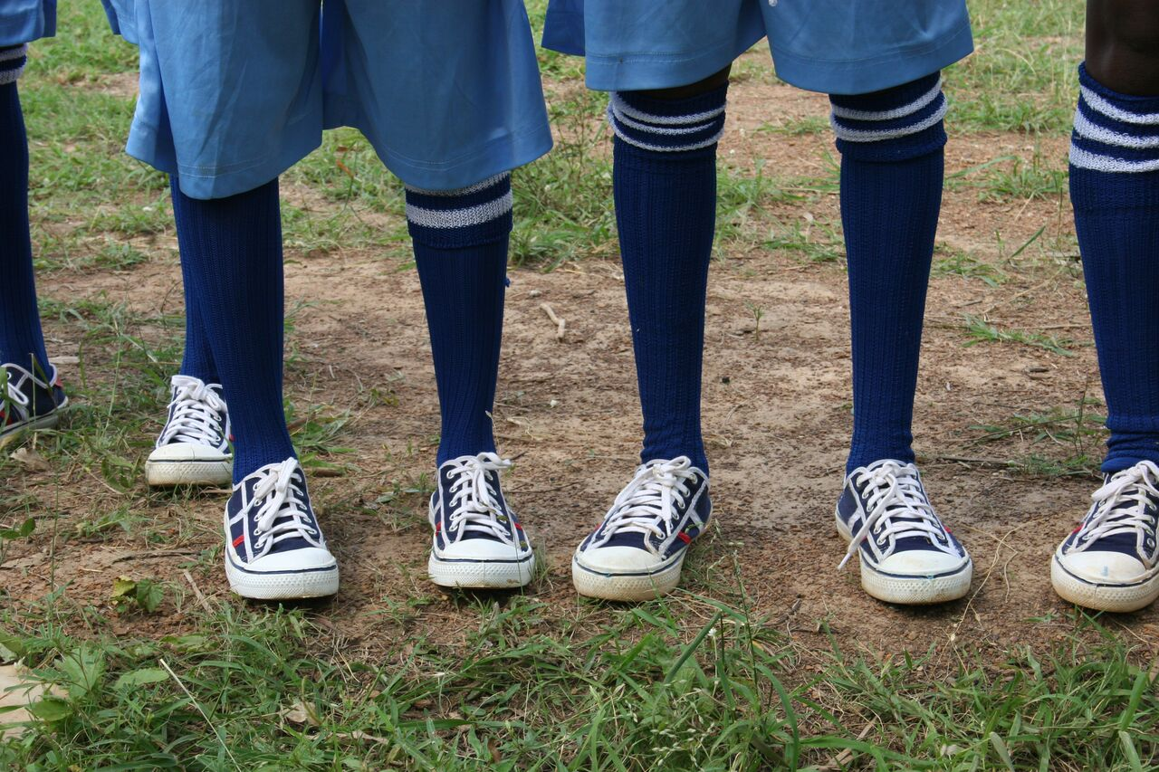
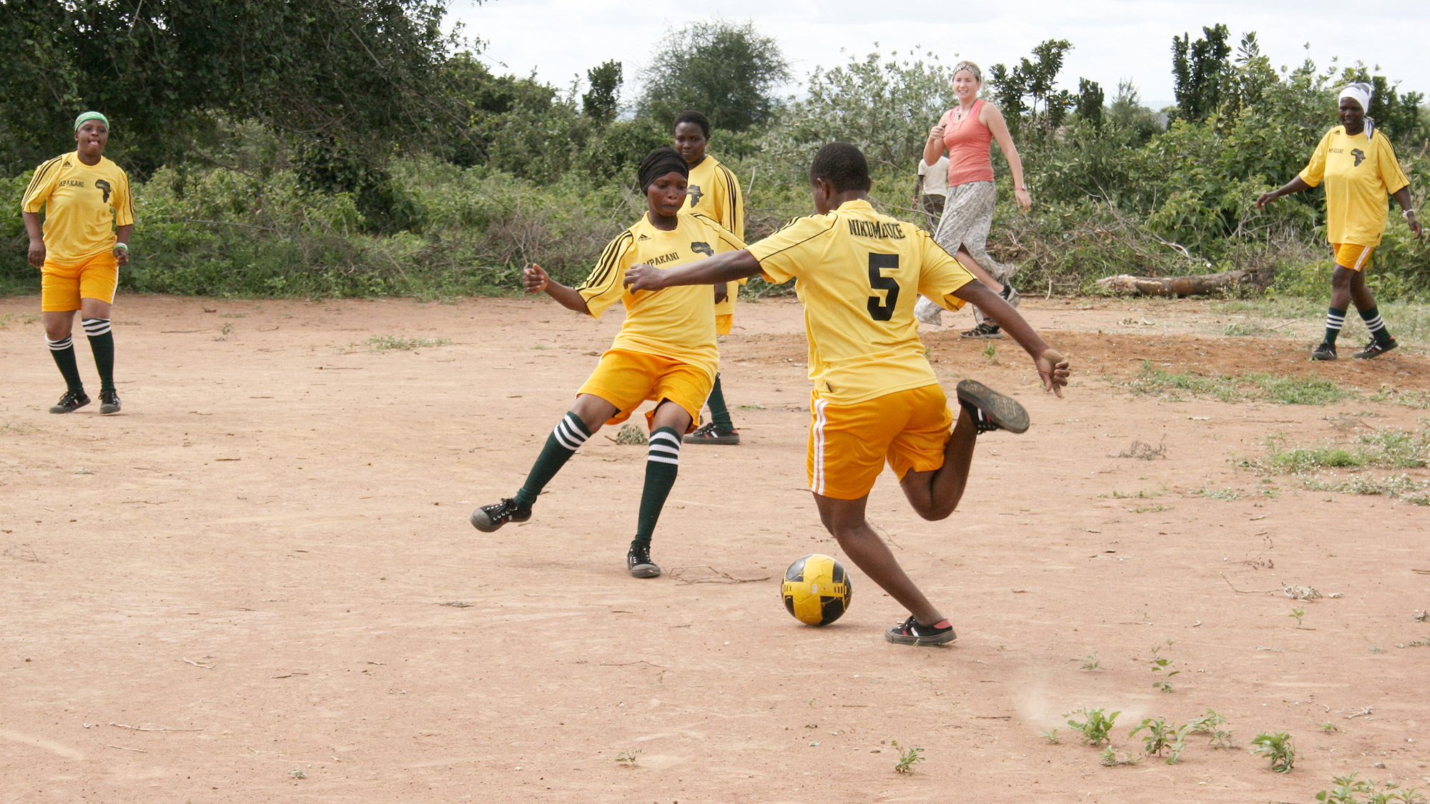
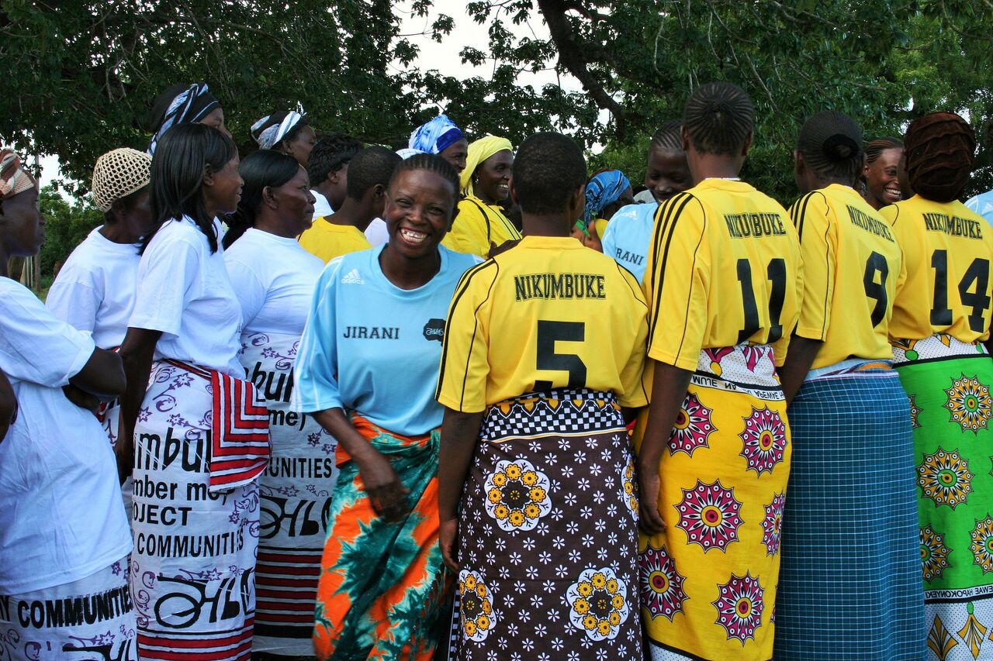
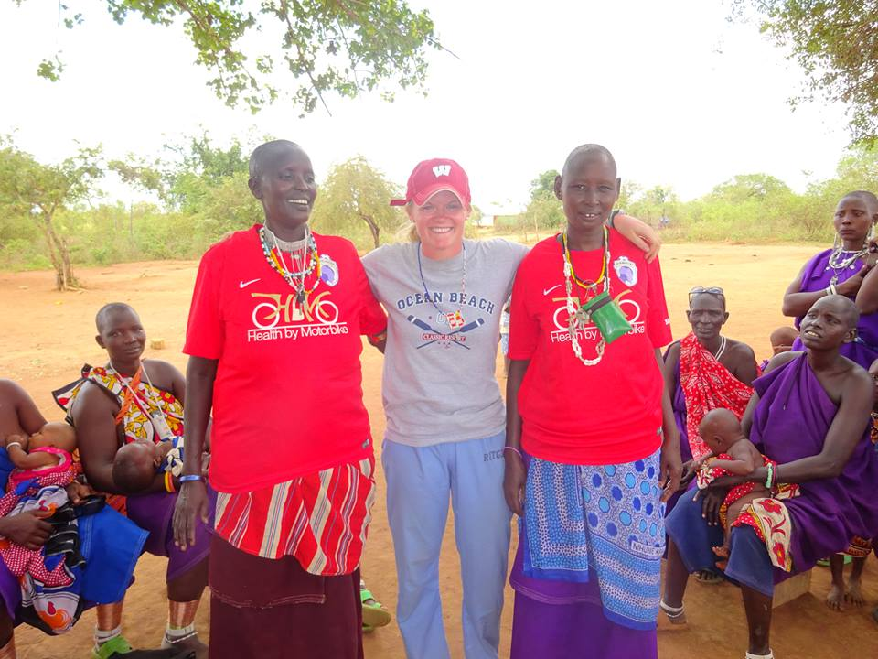
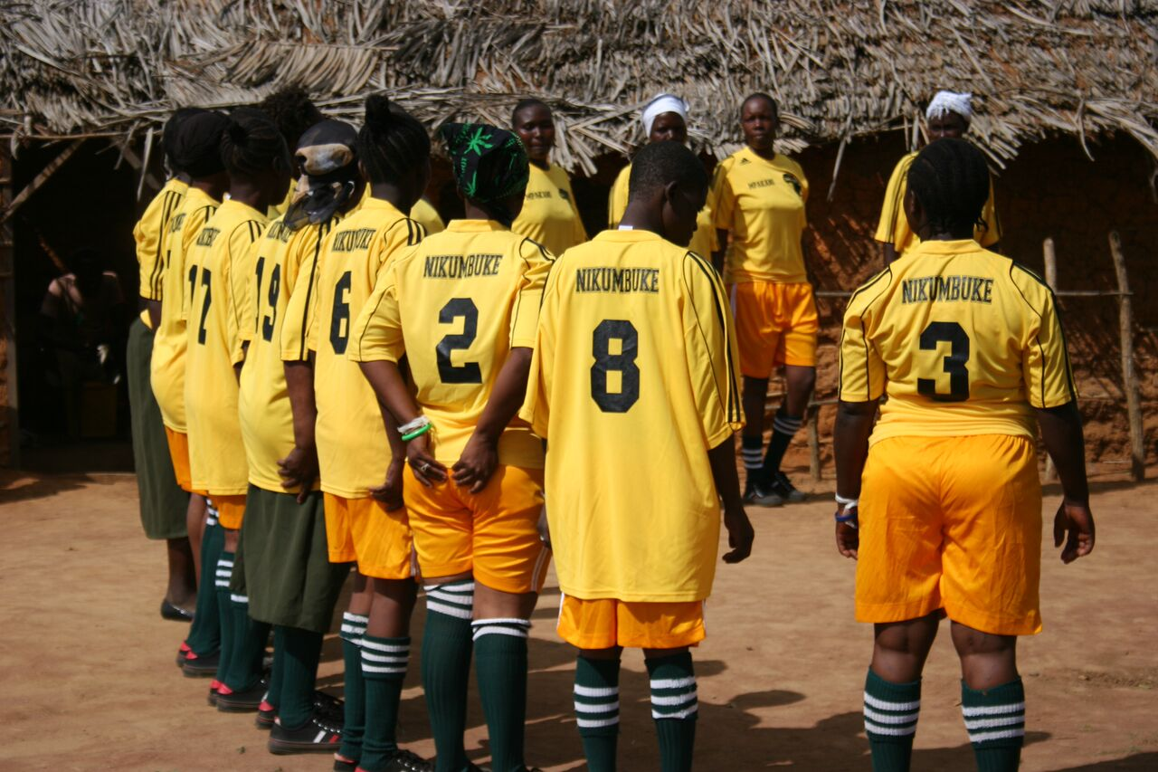
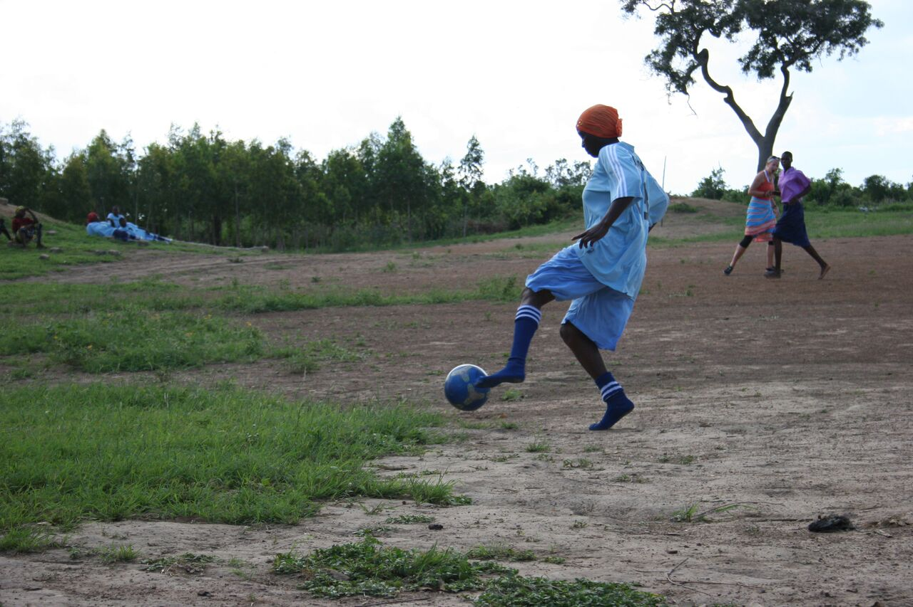
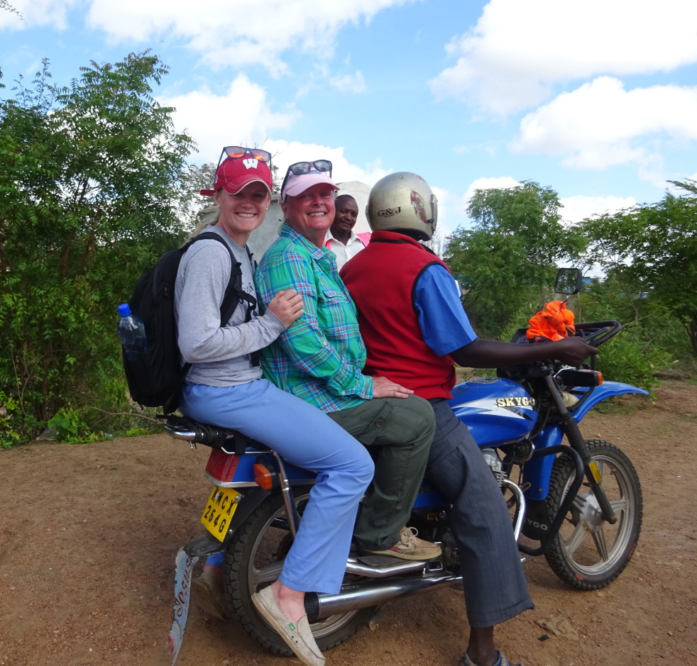
Soccer Improving Women’s Health in Rural Southeastern Kenya Brittany Ammerman, Masters of Biomedical Sciences Graduate Student Mentored by Dr. Charletta Ayers Women’s Health Institute
Background: The healthcare needs and outlets in the villages of rural Southeastern Kenya are very scarce and access to healthcare is near impossible. Women in rural Kenya are disproportionally affected by diseases and illnesses. The women of the villages that the Nikumbuke Soccer League work with carry a triple burden in caring for their children, the elderly, and the sick. They are also burdened with walking long hours to find water and working on farms or in family enterprises for little to no income. Furthermore, many of the women have more children than is desired due to poor access to education, contraception, decent employment opportunities, and sexual and reproductive health information and services. There is no maternal unit or emergency obstetric care nearby resulting in many at-home births, preventable maternal deaths, and complications during childbirth.
In 2013, Brittany Ammerman traveled to Kenya with a group from the University of Wisconsin-Madison, Health by Motorbike. The purpose of the trip was to educate 14 women and men from 7 villages to become health promoters to their respective village. The curriculum was developed by the UW-Madison students and focused on maternal health, women’s health, nutrition, domestic violence, and more. The students, along with a nurse, took motorbikes to each village once per week to educate on health and provide clinics. While there, Brittany bought a soccer ball from a local vendor and the women of the villages took to playing the sport; they then asked for a soccer league to compete. The Nikumbuke Soccer League is a certified 501(c)3 nonprofit organization founded in 2013. Through multiple health initiatives, the Nikumbuke Soccer League provides women and girls the opportunity to participate in sport, receive an education, grow their businesses, and lead healthier lives.
Since 2013, the Nikumbuke Soccer League (NSL) has grown from two teams to eight teams, involving seven village teams and one adolescent-aged team. NSL now focuses on multiple health initiatives to allow the women to participate in the Soccer League. NSL’s current initiatives include: providing water tanks for clean water, sponsoring youth girls to receive an education, sponsoring adult women to grow their businesses, providing motorbikes to the villages as a mode of transportation to local health clinics, combating diabetes through proper nutrition and physical activity, and more. The Nikumbuke Soccer League aims to further health initiatives to allow women to participate in soccer and to therefore lead healthier lives.
Diabetes:
Diabetes is an extremely prevalent disease in Kenya. The World Health Organization estimates that 1% of all deaths in Kenya in 2012 were due to diabetes (while also noting this percentage is most likely an underestimate).¹ Many women in the villages NSL works with are overweight and inactive, thus acting as primary risk factors for their development of diabetes.
NSL Program:
In this area, the only plausible treatment is better nutrition and promoting physical activity. The Nikumbuke Soccer League functions in providing both of these. Through participating in practice twice monthly and competition once monthly, women of the Soccer League have significantly increased their physical activity resulting in weight loss, therefore combating diabetes.
Maternal Health:. The World Health Organization reported in 2009 56% of Kenyan women deliver at home and only 44% of births were assisted by healthcare professionals². Many women give birth at home due to lack of transportation and access to healthcare.
NSL Program:
Since Health by Motorbike’s initiative in this area, maternal health has become a priority and a point of education. In coordination with Health by Motorbike, NSL has helped women of the Soccer League become better educated in maternal health on the levels of at-home births, how and when to cut the umbilical cord, and more. To help with lack of access to healthcare facilities, the Nikumbuke Soccer League aims to raise funds to donate motorbikes to each village to provide a mode of transportation to nearby healthcare facilities.
Nutrition: Due to poverty, environmental conditions, and lack of resources, many women are only able to provide white bread, chipati, and potatoes as the main foods to their families. The staple foods in Kenya are very carbohydrate-heavy and not very nutritional.
NSL Program:
The Nikumbuke Soccer League is committed to educating women of the Soccer League about proper nutrition and the health benefits of a well-balanced diet. In addition to providing this education, the Nikumbuke Soccer League also uses food as an incentive for women to attend practices and competitions. At each practice and competition, NSL provides each woman two pounds of beans to bring home to their family; this provides the women with a form of protein as well as a type of food that they do not usually splurge to buy. Along with the help of Health by Motorbike, NSL has provided a Moringa plant grinder. Moringa plant provides tremendous nutrition, and when ground can be sprinkled on staple foods to allow more vitamins and nutrients to be consumed. The women have been taught to plant Moringa trees and take care of their growth.
Domestic Violence: UN Women reports over 40% of women in Kenya have experienced physical and/or sexual intimate partner violence, although it is acknowledged that this percentage is underestimated².
NSL Program:
Many of the women of the Soccer League encounter domestic violence at home. The Nikumbuke Soccer League and Health by Motorbike have been able to provide the women the opportunity to participate in domestic violence workshops. Mentors and visiting students educate the women on what domestic violence is, signs of abuse, how to speak out about abuse, and more. Participation in the Soccer League has allowed the women to engage in lifelong friendships, discuss their familial problems, domestic violence encounters, and village problems with other women of the League, and become happier through social activity. Developing friendships and support systems in women across different village teams has given women of the Soccer League a sense of cohesion, agency, and empowerment.
References:
1. “Kenya Faces Rising Burden of Diabetes” Published in the Noncommunicable Diseases (NCD) Country Profiles, WHO, 2014
2. Kenya Demographic and Health Survey (KHDS) 2008-2009

